Slide 1
TCS Remote Internship Project
Online File Upload and Download system
TCS Mentor : Miss Farah Deeba
Mentees : Avais Ahmad (av25091995@gmail.com )
Faizul Haq (fh.haq27@gmail.com)
Tuba Sarosh (tubasarosh@hotmail.co.nz)

Slide 2
Technology Used
HTML
CSS
JAVA J2EE
ORACLE 11g database (SQL)
IDE used: Net Beans

Slide 3
Description of the project
The featured project comprises of a java web application.
It allows the user to first register himself, and then login into the website using his credentials and password.
The details provided by the user are stored in the system admin’s database.
The user can upload two files, one user ID in jpg format, and one zip file.
These files are also stored on the system admin’s server.
After uploading, the user also has the facility to re-upload the files, the old files will get replaced.
The user can also download his files whenever he wants.

Slide 4
Screenshots of the working project

Slide 5
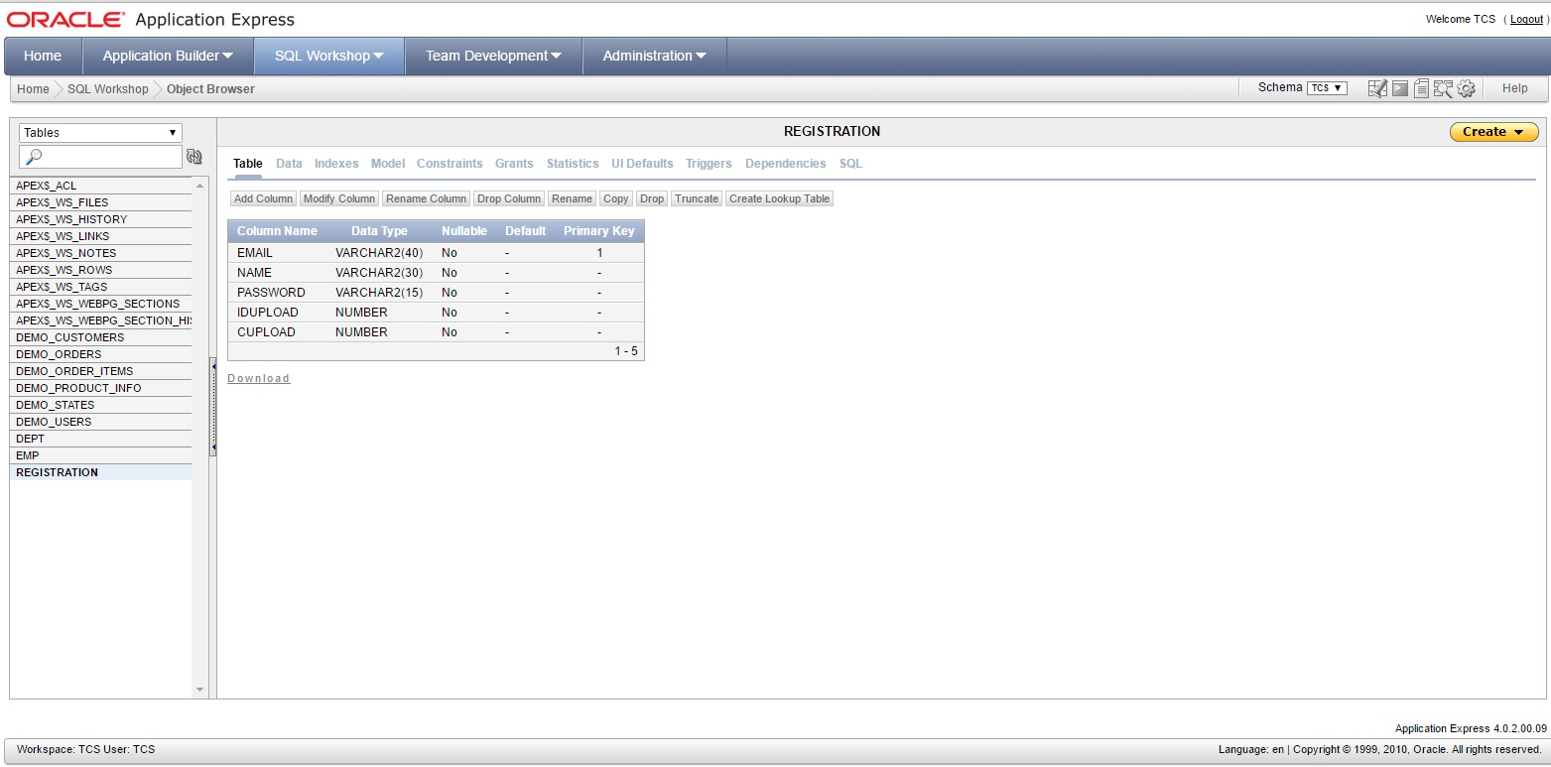
Database table layout

Slide 6
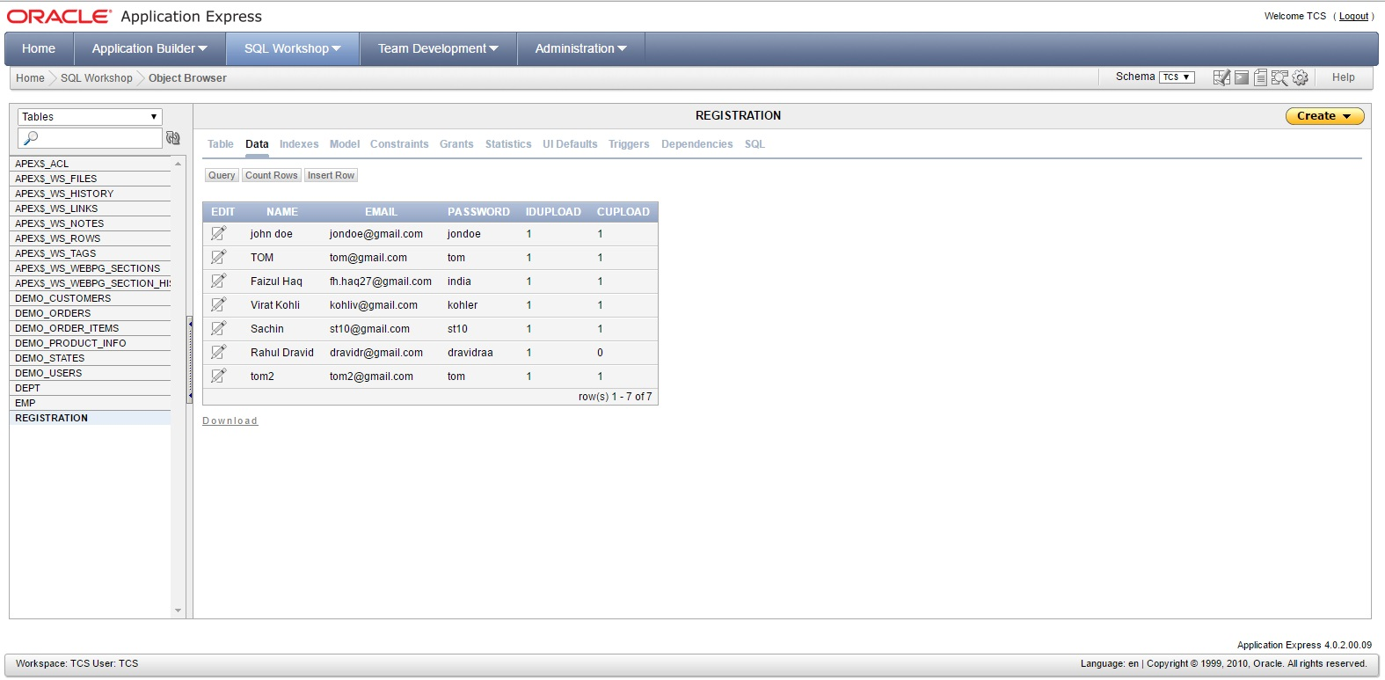
Database schema

Slide 7
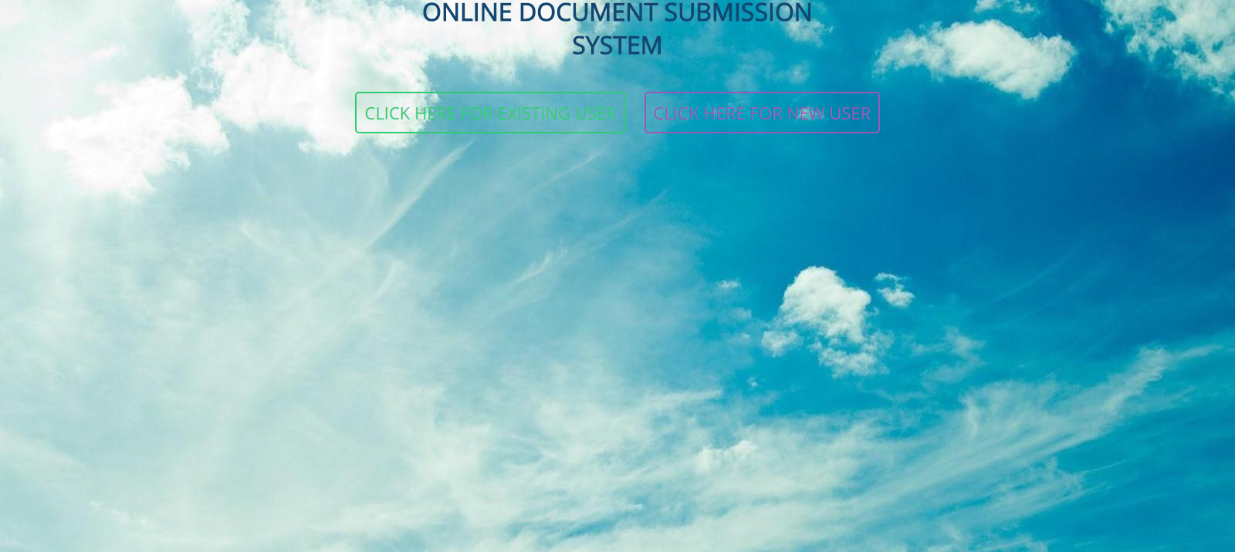
Home page of the project
New user can register himself, then login.
Already registered user can directly login.

Slide 8
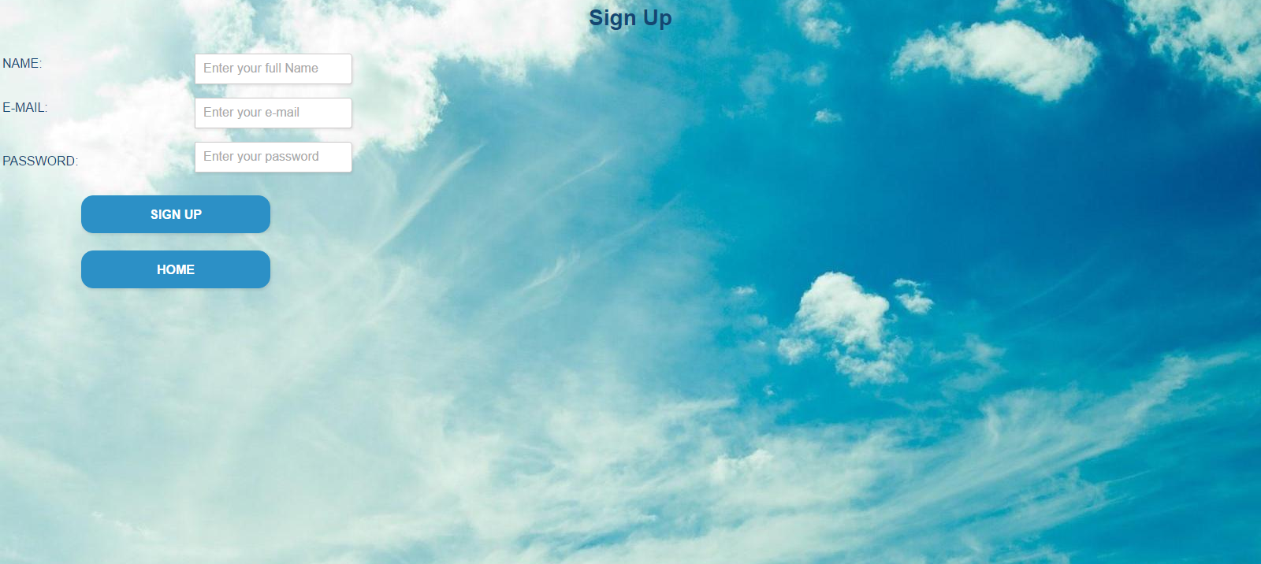
Registration home

Slide 9

Registration Successful

Slide 10

Registration Failed

Slide 11
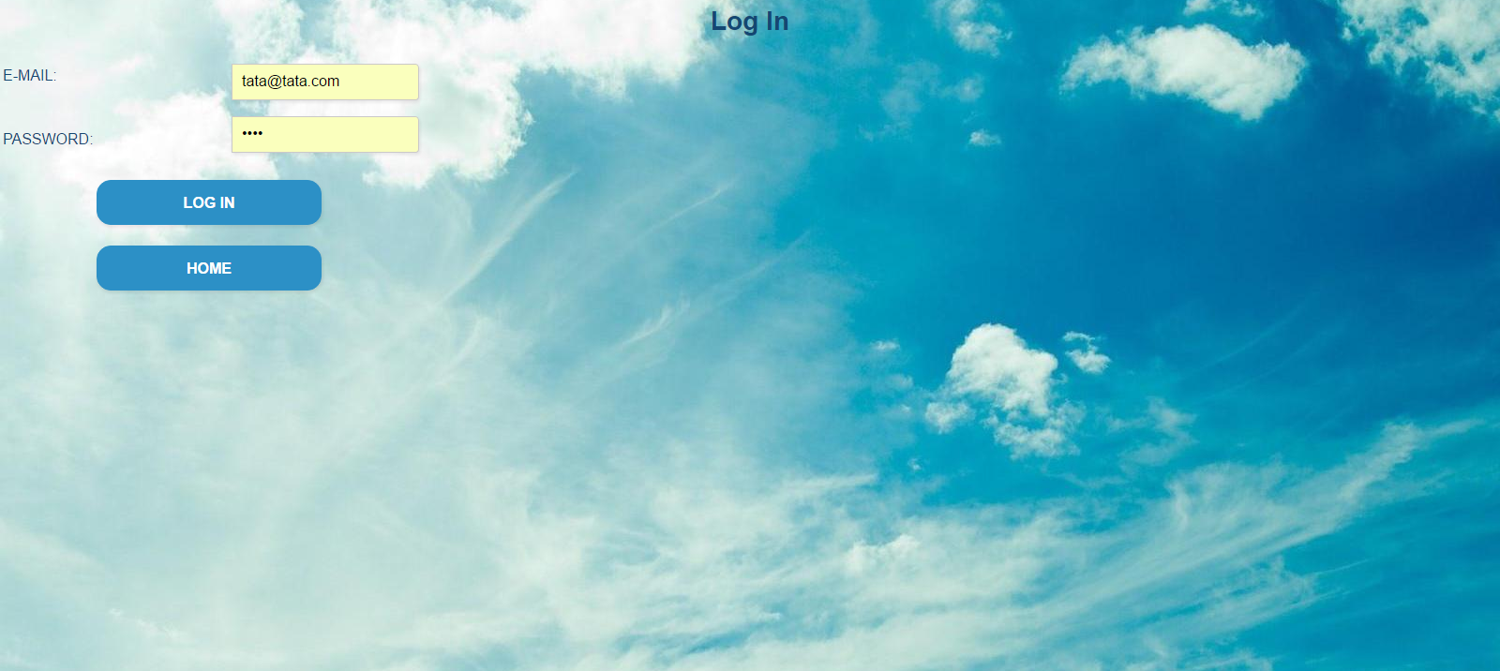
Login Page

Slide 12
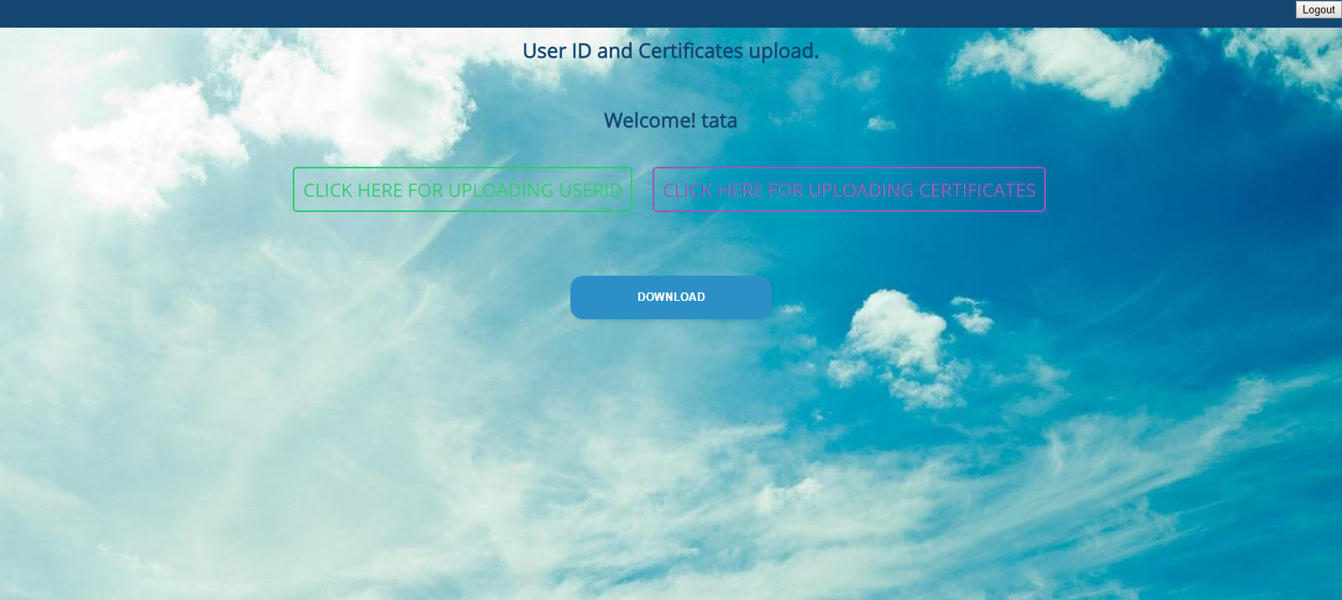
Login Successful
From here, the user can upload jpg image, zip file, or download them if already uploaded.

Slide 13
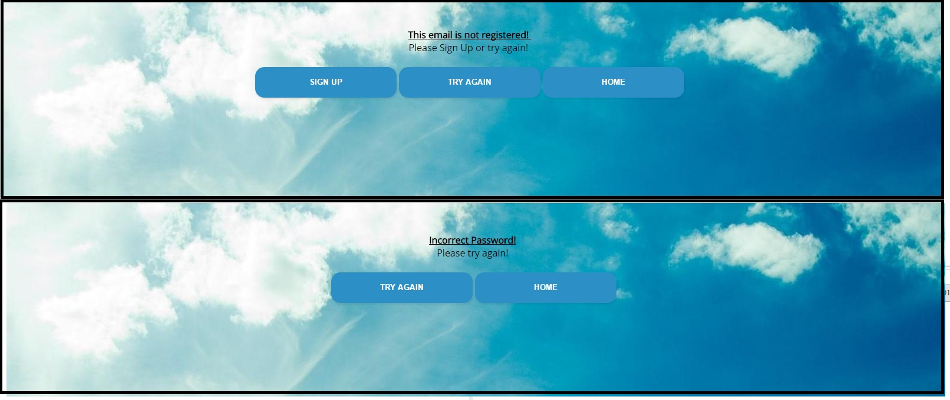
Login fail
If either the user is not registered, or the entered password is wrong.
(These are two separate screens.)

Slide 14
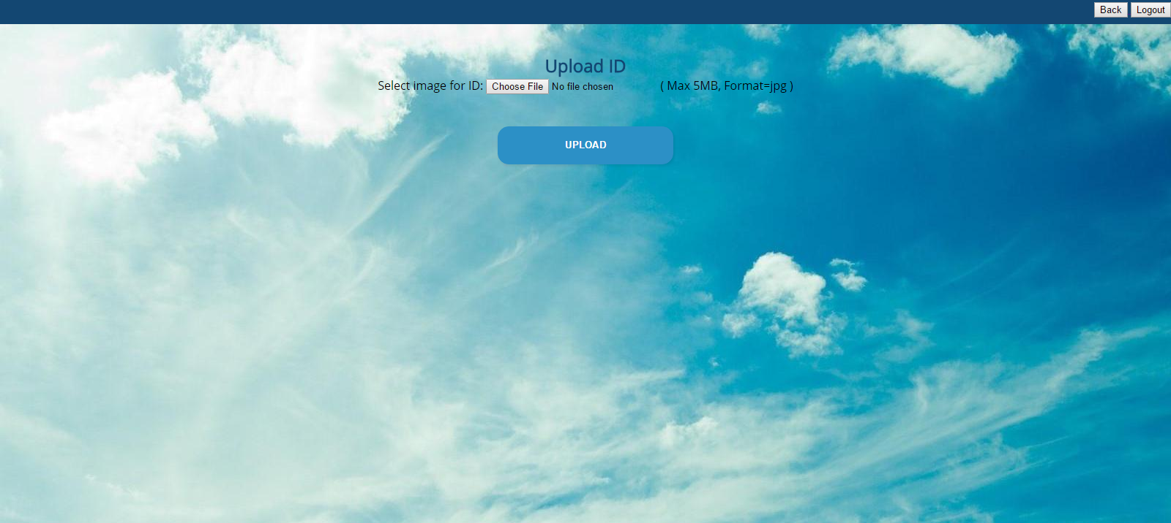
Upload ID.

Slide 15
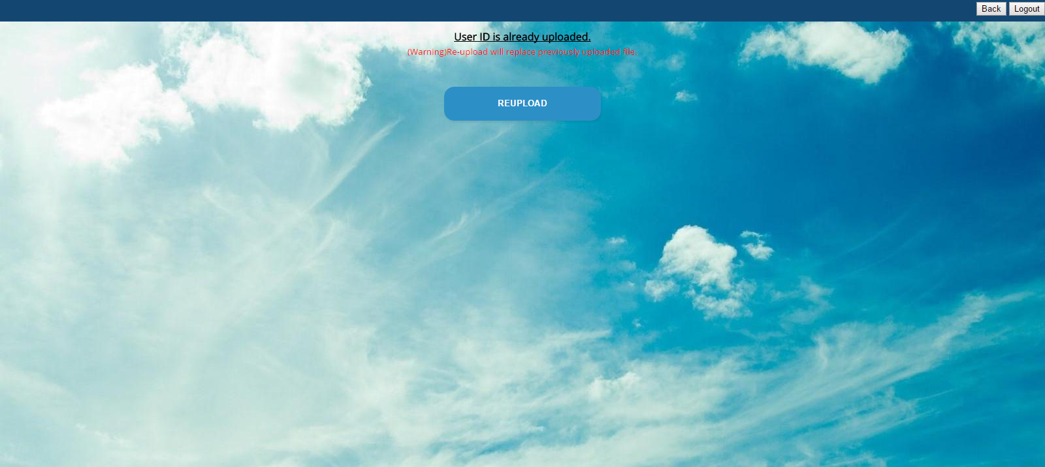
If user id has already been uploaded

Slide 16
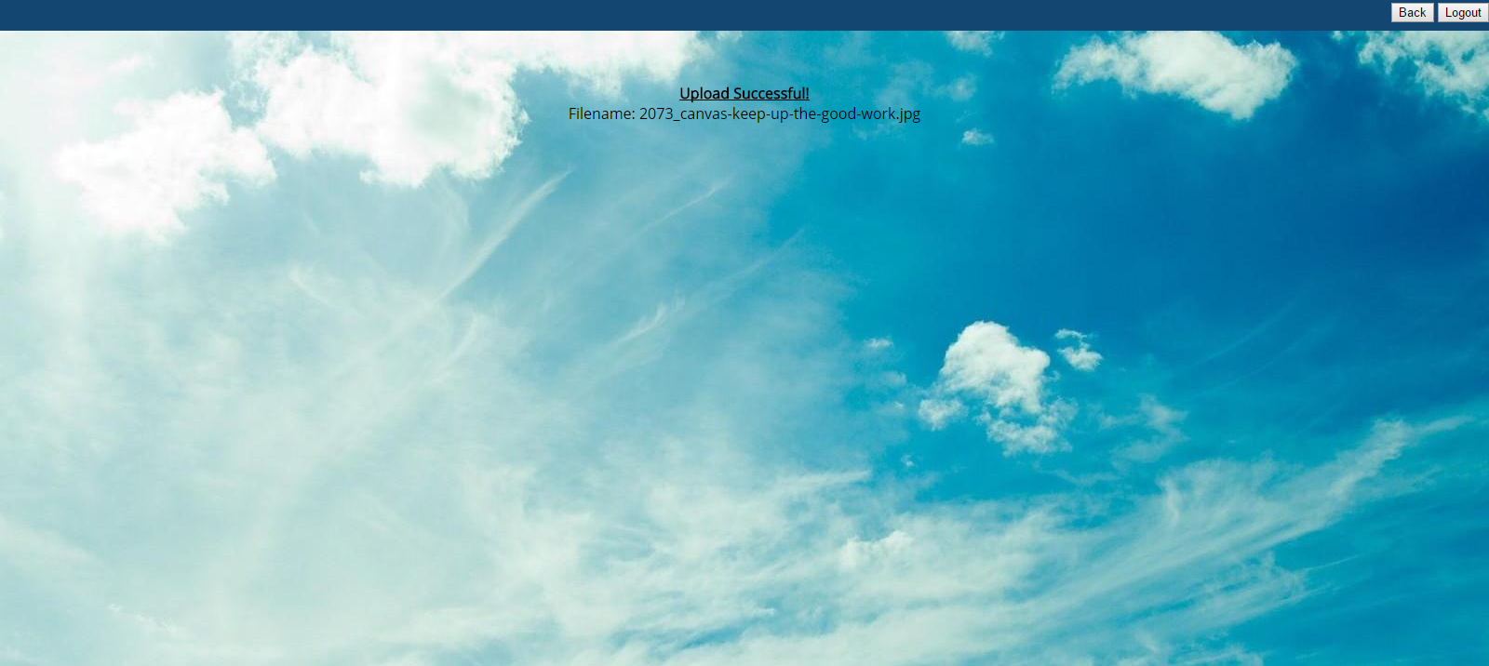
Upload Successful

Slide 17
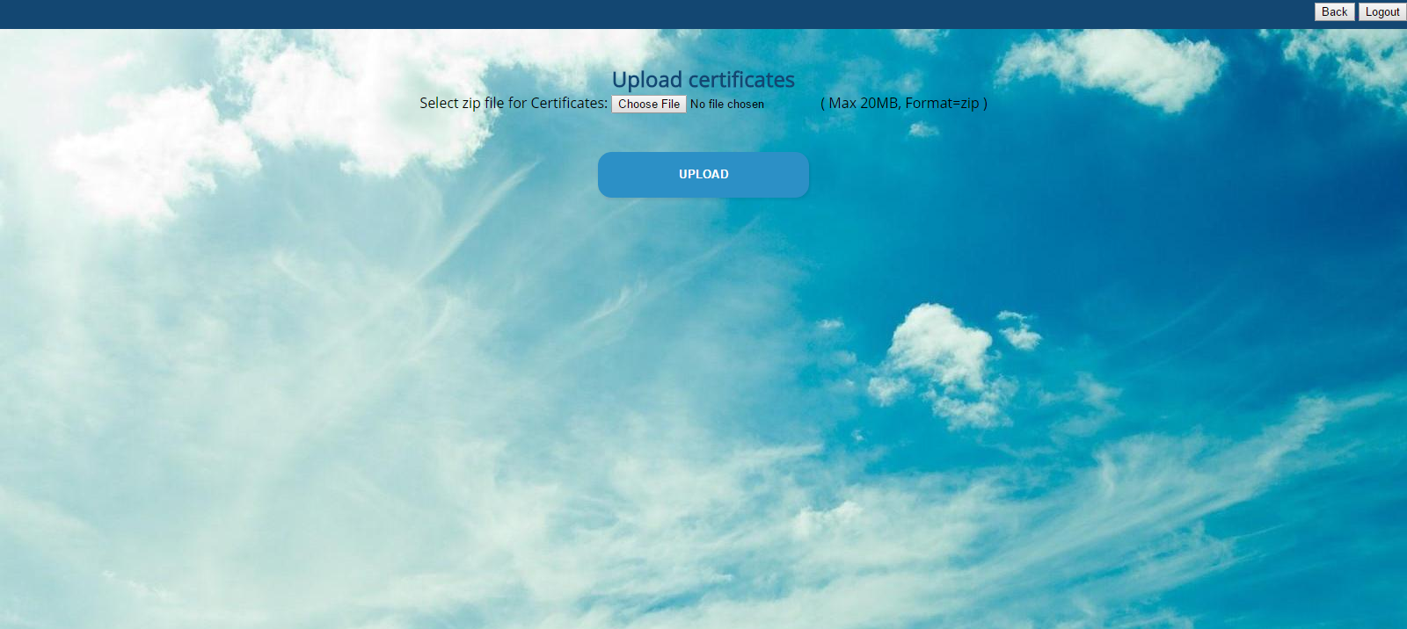
Upload zip file

Slide 18
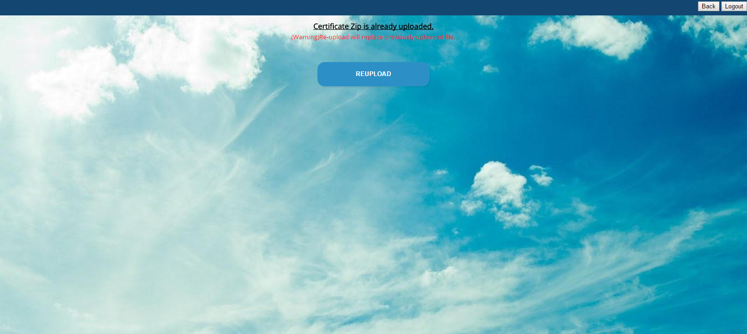
Re-upload the zip file.

Slide 19

Zip file uploaded successfully

Slide 20
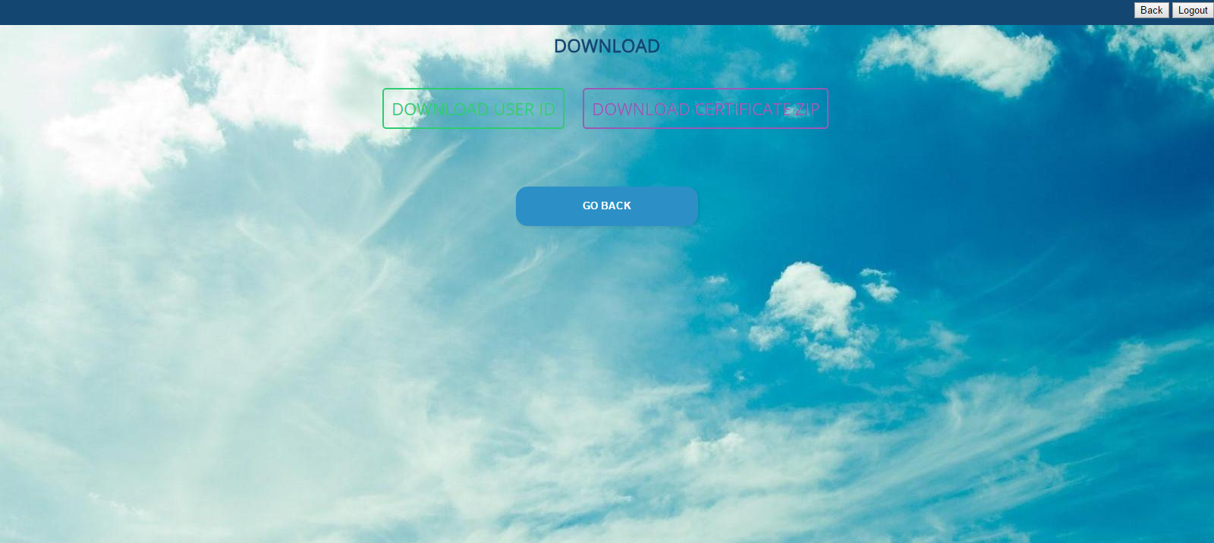
Download options
Clicking on download user id will download the user id.
Clicking on download certificate zip will download the zip file.

Slide 21
Technical details of the project
The files uploaded by the user will be uniquely identified at the server.
The email id has been used as the primary key, since no two people can have same email ids.
The jpg file well be stored with the name <email id>.jpg and the zip file will be stored with the name <email id>.zip.

Slide 22
Every time you do a project, you learn something new.
Thank you.

